Slide 1

Power Bi Sample Sales Report
By: Matt Purvis
P.S. All names and Numbers have been changed to protect sensitive data

Slide 2
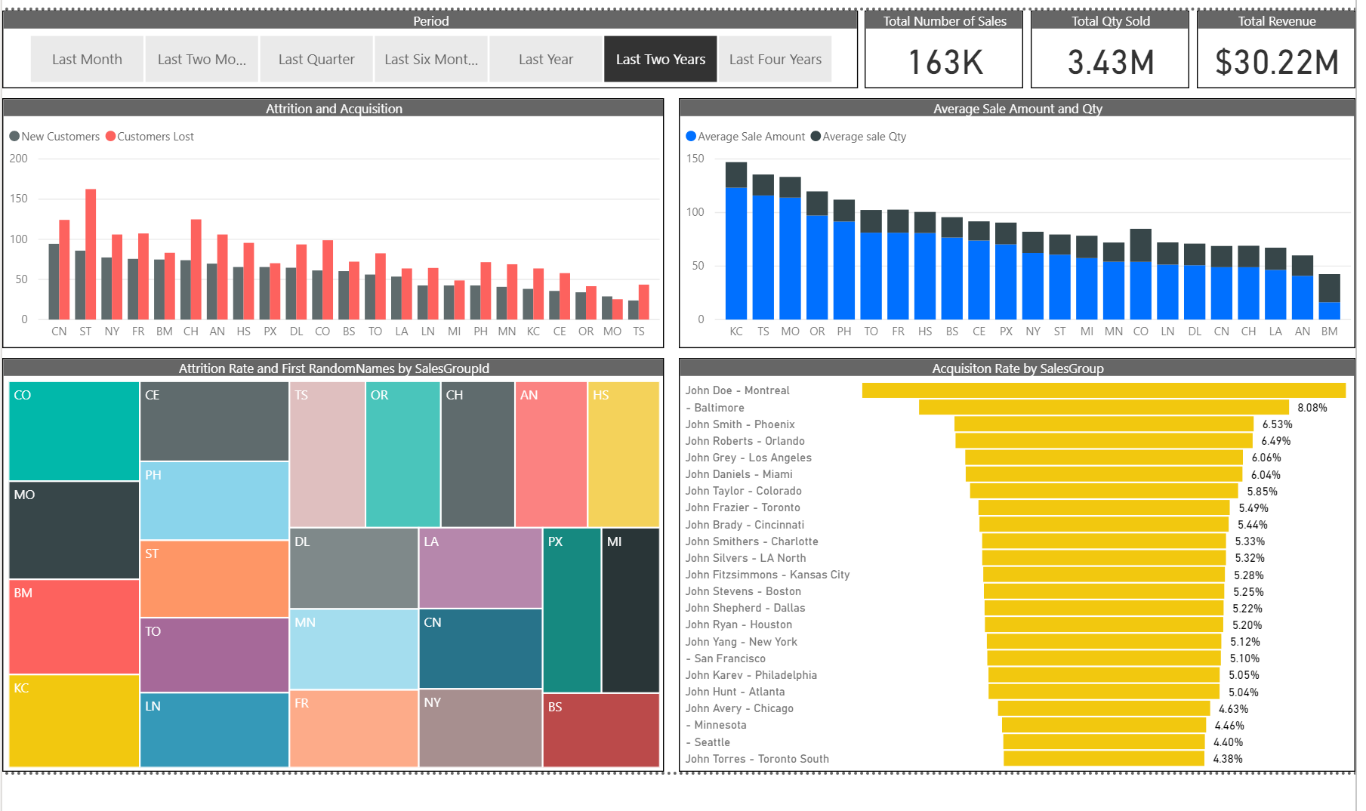

Slide 3
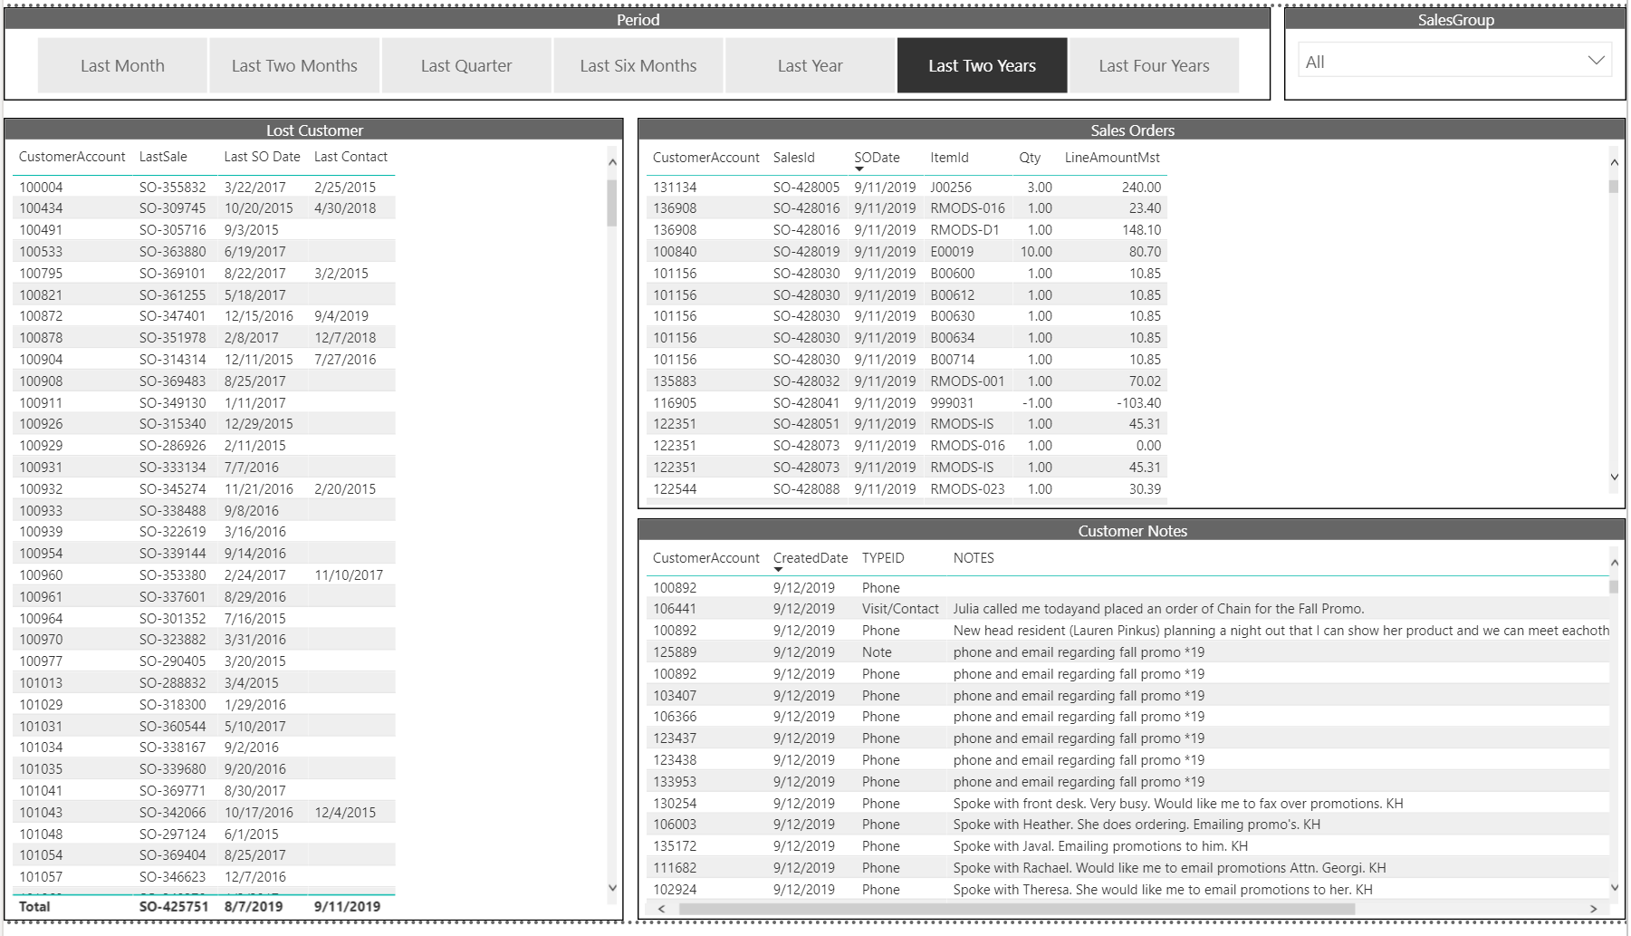

Slide 4
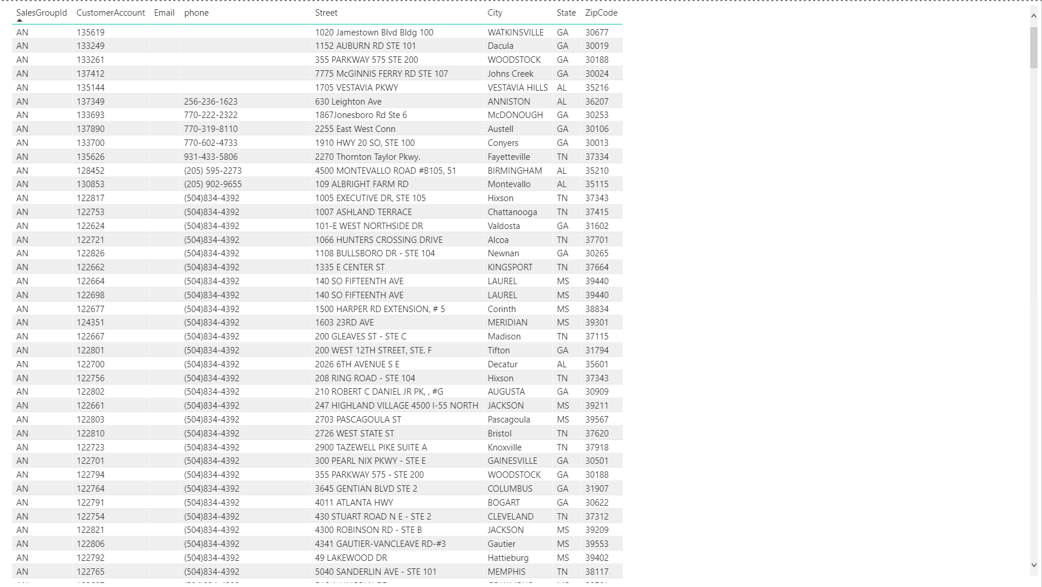

Slide 5
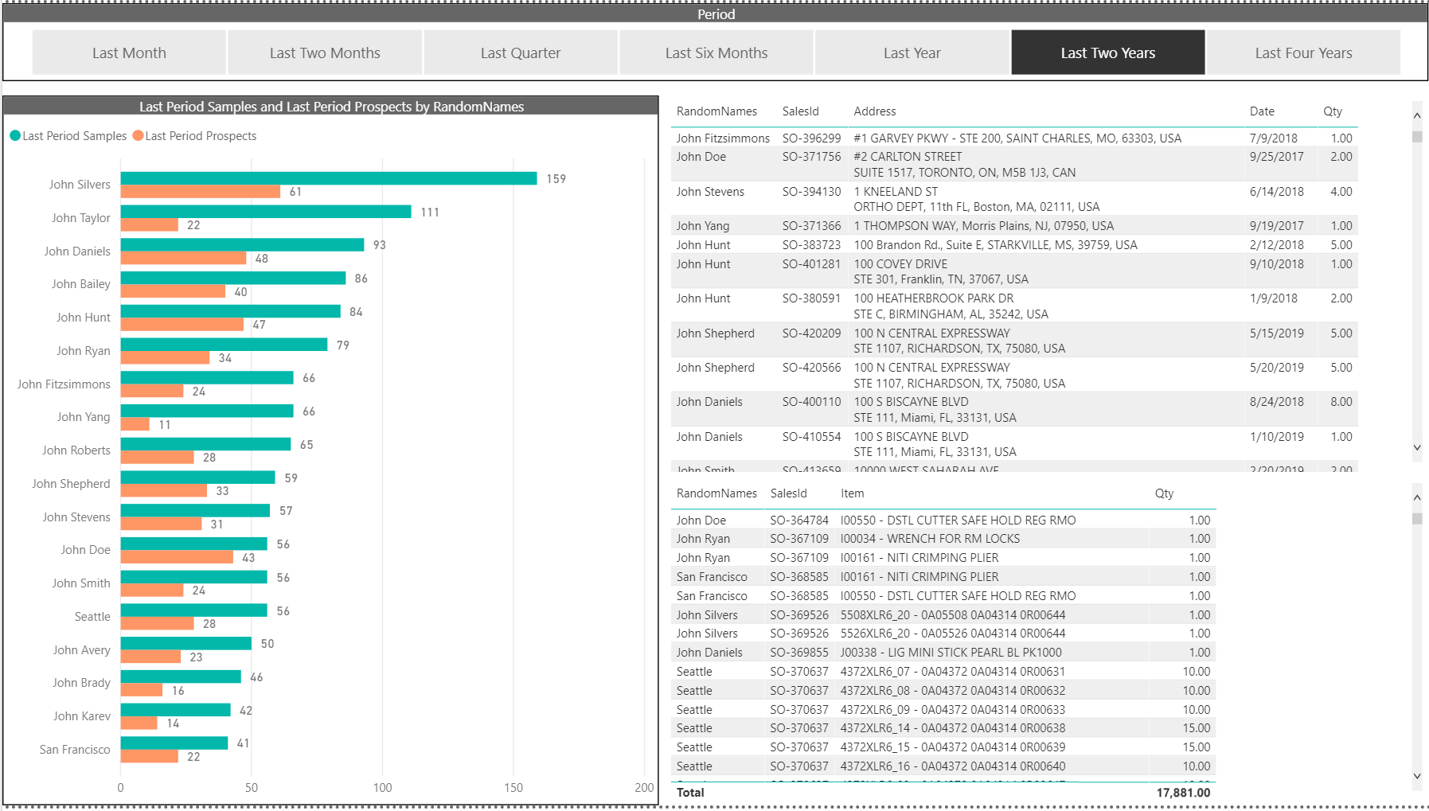

Slide 6
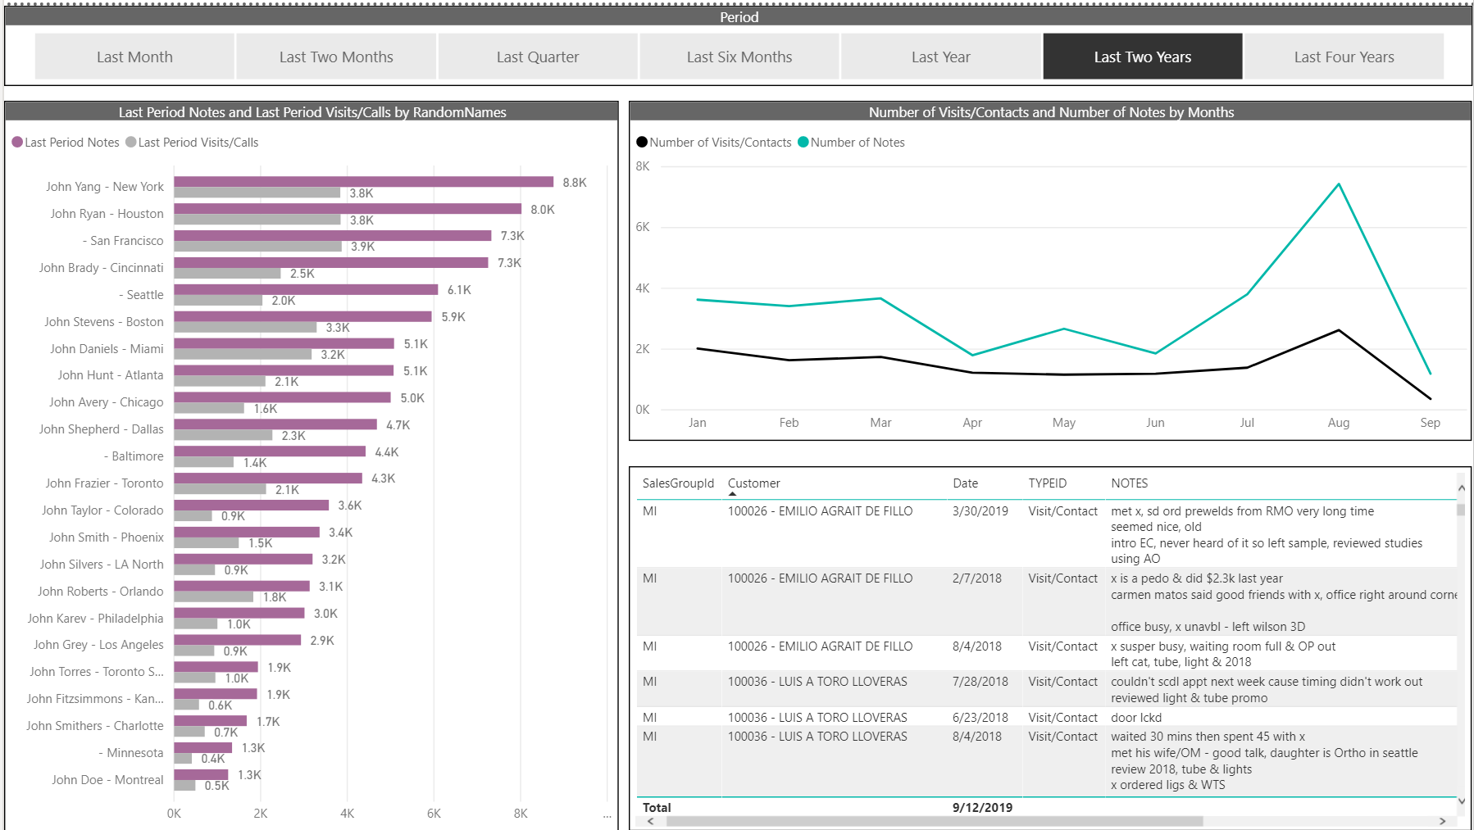

Slide 7
